Slide 1
Transportation, Assignment and Transshipment Problems

Slide 2
Vogel’s Method for Finding a Basic Feasible Solution
Begin by computing for each row (and column) a “penalty” equal to the difference between the two smallest costs in the row (column).
Next find the row or column with the largest penalty.
Choose as the first basic variable the variable in this row or column that has the smallest shipping cost.
As described in the northwest corner and minimum-cost methods, make this variable as large as possible, cross out a row or column, and change the supply or demand associated with the basic variable.
Now recompute new penalties (using only cells that do not lie in a crossed-out row or column), and repeat the procedure until only one uncrossed cell remains.
Set this variable equal to the supply or demand associated with the variable, and cross out the variable’s row and column.
A bfs has now been obtained.

Slide 3
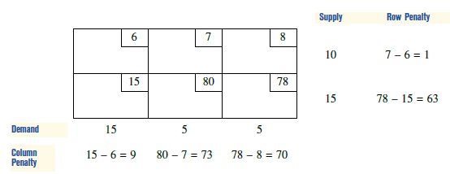
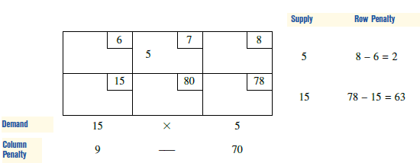
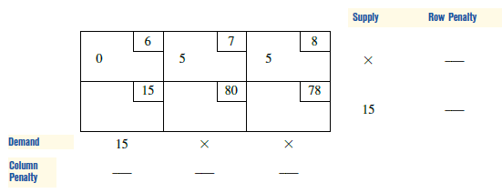
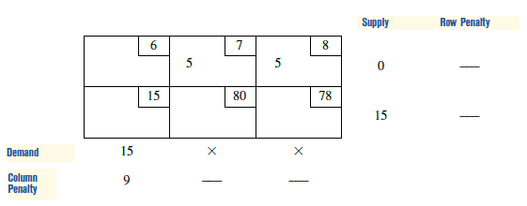
Example

Slide 4
The Transportation Simplex Method
In this section, we show how the simplex algorithm simplifies when a transportation problem is solved.
We begin by discussing the pivoting procedure for a transportation problem.
Recall that when the pivot row was used to eliminate the entering basic variable from other constraints and row 0, many multiplications were usually required.
In solving a transportation problem, however, pivots require only additions and subtractions.

Slide 5
How to Pivot in a Transportation Problem
By using the following procedure, the pivots for a transportation problem may be performed within the confines of the transportation tableau:
Step 1 Determine (by a criterion to be developed shortly) the variable that should enter the basis.
Step 2 Find the loop (it can be shown that there is only one loop) involving the entering variable and some of the basic variables.
Step 3 Counting only cells in the loop, label those found in step 2 that are an even number
(0, 2, 4, and so on) of cells away from the entering variable as even cells.
Also label those that are an odd number of cells away from the entering variable as odd cells.

Slide 6
Step 4 Find the odd cell whose variable assumes the smallest value. Call this value θ .
The variable corresponding to this odd cell will leave the basis.
To perform the pivot, decrease the value of each odd cell by θ and increase the value of each even cell by θ .
The values of variables not in the loop remain unchanged.
The pivot is now complete.
If θ =0, then the entering variable will equal 0, and an odd variable that has a current value of 0 will leave the basis.
In this case, a degenerate bfs existed before and will result after the pivot.
If more than one odd cell in the loop equals θ , you may arbitrarily choose one of these odd cells to leave the basis; again, degenerate bfs will result.

Slide 7
Let’s illustrate the situation in Powerco Problem when initial bfs is found with Northwest Corner Method.

Slide 8

Pricing Out Nonbasic Variables
To complete our discussion of the transportation simplex, we now show how to compute row 0 for any bfs
we know that for a bfs in which the set of basic variables is BV, the coefficient of the variable x_{ij} (call it ) in the tableau’s row 0 is given by
where c_{ij} is the objective function coefficient for x_{ij} and a_{ij} is the column for x_{ij} in the original LP (we are assuming that the first supply constraint has been dropped).

Slide 9

Because we are solving a minimization problem, the current bfs will be optimal if all the ’s are nonpositive; otherwise, we enter into the basis the variable with the most positive .
After determining , we can easily determine .
Because the first constraint has been dropped, will have m + n - 1 elements. We write

Slide 10

To determine , we use the fact that in any tableau, each basic variable x_{ij} must have = 0.
Thus, for each of the m + n - 1 variables in BV,
For a transportation problem, the equations in (4) are very easy to solve.
To illustrate the solution of (4), for Powerco.

Slide 11
For each nonbasic variable, we now compute
Since all NBV’s Row 0 coefficients have to be ≤ 0 (since this is a minimization problem) we need to choose the most positive as the entering variable.

Slide 12
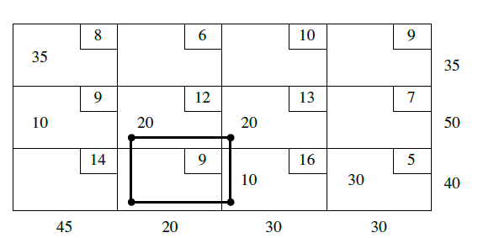
Since the entering variable is x32 then the result of the iteration is;

Slide 13
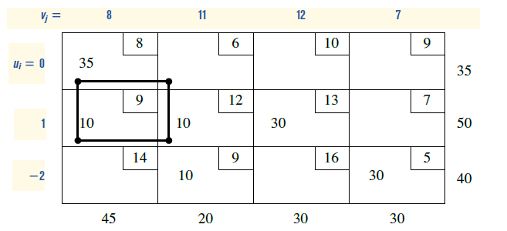
Since the entering variable is x12 the result of the iteration is;

Slide 14
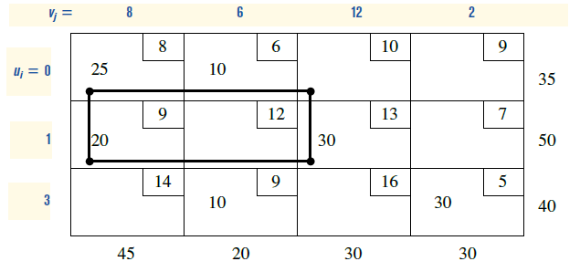
Since the entering variable is x13 the result of the iteration is;

Slide 15
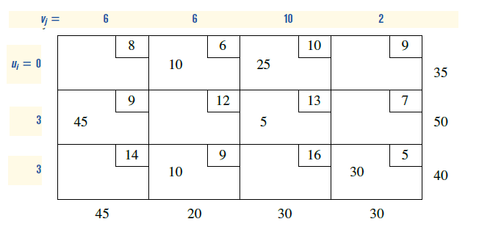

Slide 16
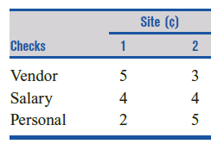
Example
A bank has two sites at which checks are processed.
Site 1 can process 10,000 checks per day, and site 2 can process 6,000 checks per day.
The bank processes three types of checks: vendor, salary, and personal.
The processing cost per check depends on the site (see Table).
Each day, 5,000 checks of each type must be processed.
Formulate and solve a balanced transportation problem to minimize the daily cost of processing checks. (Use North Westmethod for the initial bfs)

Slide 17
Sensitivity Analysis for Transportation Problems
Change 1 Changing the objective function coefficient of a nonbasic variable.
Change 2 Changing the objective function coefficient of a basic variable.
Change 3 Increasing a single supply by ∆ and a single demand by ∆.

Slide 18
Change 1: Objective function coefficient of a NBV
We are not changing c_{BV}B⁻¹, so the ui’s and vj’s remain unchanged.
In row 0, only the coefficient of xij will change. Thus, as long as the coefficient of xij in the optimal row 0 is nonpositive, the current basis remains optimal.

Slide 19
Change 2: Changing the objective function coefficient of a BV
Because we are changing c_{BV}B⁻¹, the coefficient of each nonbasic variable in row 0 may change, and to determine whether the current basis remains optimal, we must find the new ui’s and vj’s and use these values to price out all nonbasic variables.
The current basis remains optimal as long as all nonbasic variables price out nonpositive.

Slide 20
Change 3: Increasing both supply and Demand by ∆
Observe that this change maintains a balanced transportation problem.
Because the ui’s and vj’s may be thought of as the negative of each constraint’s shadow prices,
we know that if the current basis remains optimal,

Slide 21
We may also find the new values of the decision variables as follows:
1) If xij is a basic variable in the optimal solution, then increase xij by ∆ .
2) If xij is a nonbasic variable in the optimal solution, then find the loop involving xij and some of the basic variables.
Find an odd cell in the loop that is in row i. Increase the value of this odd cell by ∆ and go around the loop, alternately increasing and then decreasing current basic variables in the loop by ∆ .

Slide 22
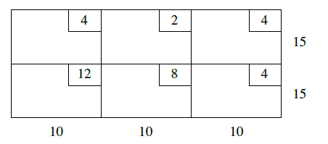
Example
Consider the balanced transportaton problem given in table.
a) Find the optimal solution (Use Northwest Corner as the initial bfs)
b) For what values of c12 and c21 The current basis remain optimal?
c) if s1 and d1 is increased by 2 units what will be the new optimal solution?
d) if s1 And d3 is increased by 1 units what will be the new optimal solution)

Slide 23
Assignment Problems
Machineco has four machines and four jobs to be completed.
Each machine must be assigned to complete one job. The time required to set up each machine for completing each job is shown in Table.
Machineco wants to minimize the total setup time needed to complete the four jobs.
Use linear programming to solve this problem.

Slide 24
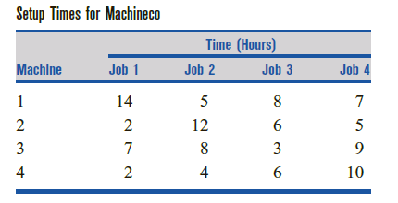

Slide 25
Ignoring for the moment the xij= 0 or xij = 1 restrictions, we see that Machineco faces a balanced transportation problem in which each supply point has a supply of 1 and each demand point has a demand of 1.
In general, an assignment problem is a balanced transportation problem in which all supplies and demands are equal to 1.
Thus, an assignment problem is characterized by knowledge of the cost of assigning each supply point to each demand point.
The assignment problem’s matrix of costs is its cost matrix.
Because the right-hand side of each constraint is equal to 1, each xij must be a nonnegative integer that is no larger than 1, so each xij must equal 0 or 1.
This means that we can ignore the restrictions that xij 0 or 1

Slide 26
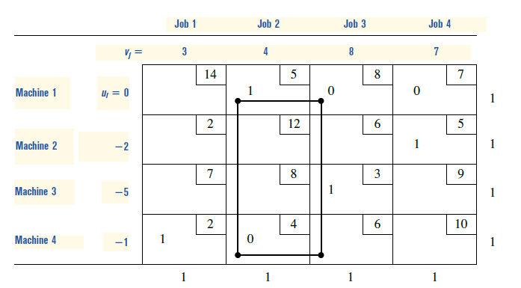

Slide 27
Hungarian Method
Looking back at our initial bfs, we see that it was an optimal solution.
We did not know that it was optimal, however, until performing one iteration of the transportation simplex.
This suggests that the high degree of degeneracy in an assignment problem may cause the transportation simplex to be an inefficient way of solving assignment problems.
For this reason (and the fact that the algorithm is even simpler than the transportation simplex), the Hungarian method is usually used to solve assignment (min) problems:

Slide 28
Step 1 Find the minimum element in each row of the m X m cost matrix. Construct a new matrix by subtracting from each cost the minimum cost in its row. For this new matrix, find the minimum cost in each column. Construct a new matrix (called the reduced cost matrix) by subtracting from each cost the minimum cost in its column.
Step 2 Draw the minimum number of lines (horizontal, vertical, or both) that are needed to cover all the zeros in the reduced cost matrix. If m lines are required, then an optimal solution is available among the covered zeros in the matrix. If fewer than m lines are needed, then proceed to step 3.
Step 3 Find the smallest nonzero element (call its value k) in the reduced cost matrix that is uncovered by the lines drawn in step 2. Now subtract k from each uncovered element of the reduced cost matrix and add k to each element that is covered by two lines. Return to step 2.

